Slide 1
GENERAL ELECTION OF INDIA-2024
PRESENTED BY
TANJU GOGOI

Slide 2

--Total_Seats Query: SELECT COUNT(constituencywise_results.[Parliament Constituency])AS Total_Seats FROM constituencywise_results;
OUTPUT:

Slide 3
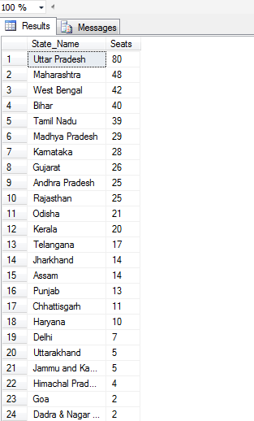
--Total number of seats available for elections in each states. Query: SELECT states.[State] As State_Name, COUNT(statewise_results.[Parliament Constituency])As Seats From statewise_results JOIN states On states.[State ID]=statewise_results.[State ID] Group By states.[State] ORDER BY COUNT(statewise_results.[Parliament Constituency]) DESC;
OUTPUT:

Slide 4
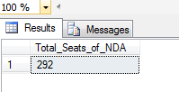
--Total Seats Won by NDA Alliance. Query: SELECT SUM(partywise_results.Won)AS Total_Seats_of_NDA FROM partywise_results WHERE partywise_results.[Party] IN( 'Bharatiya Janata Party - BJP', 'Telugu Desam - TDP', 'Janata Dal (United) - JD(U)', 'Shiv Sena - SHS', 'AJSU Party - AJSUP', 'Apna Dal (Soneylal) - ADAL', 'Asom Gana Parishad - AGP', 'Hindustani Awam Morcha (Secular) - HAMS', 'Janasena Party - JnP', 'Janata Dal (Secular) - JD(S)', 'Lok Janshakti Party(Ram Vilas) - LJPRV', 'Nationalist Congress Party - NCP', 'Rashtriya Lok Dal - RLD', 'Sikkim Krantikari Morcha - SKM');
OUTPUT:

Slide 5
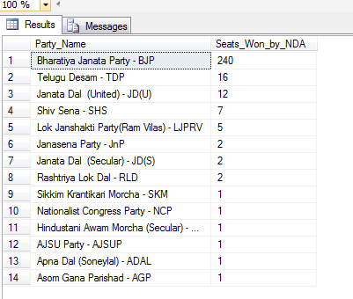
--Seats Won by NDA Alliance Parties. Query: SELECT partywise_results.Party AS Party_Name, partywise_results.Won AS Seats_Won_by_NDA FROM partywise_results WHERE partywise_results.[Party] IN( 'Bharatiya Janata Party - BJP', 'Telugu Desam - TDP', 'Janata Dal (United) - JD(U)', 'Shiv Sena - SHS', 'AJSU Party - AJSUP', 'Apna Dal (Soneylal) - ADAL', 'Asom Gana Parishad - AGP', 'Hindustani Awam Morcha (Secular) - HAMS', 'Janasena Party - JnP', 'Janata Dal (Secular) - JD(S)', 'Lok Janshakti Party(Ram Vilas) - LJPRV', 'Nationalist Congress Party - NCP', 'Rashtriya Lok Dal - RLD', 'Sikkim Krantikari Morcha - SKM') ORDER BY partywise_results.Won DESC;
OUTPUT:

Slide 6
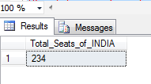
--Total Seats Won by I.N.D.I.A. Query: SELECT SUM(partywise_results.Won)AS Total_Seats_of_INDIA FROM partywise_results WHERE partywise_results.[Party] IN( 'Indian National Congress - INC', 'Aam Aadmi Party - AAAP', 'All India Trinamool Congress - AITC', 'Bharat Adivasi Party - BHRTADVSIP', 'Communist Party of India (Marxist) - CPI(M)', 'Communist Party of India (Marxist-Leninist) (Liberation) - CPI(ML)(L)', 'Communist Party of India - CPI', 'Dravida Munnetra Kazhagam - DMK', 'Indian Union Muslim League - IUML', 'Jammu & Kashmir National Conference - JKN', 'Kerala Congress - KEC', 'Jharkhand Mukti Morcha - JMM', 'Marumalarchi Dravida Munnetra Kazhagam - MDMK', 'Nationalist Congress Party Sharadchandra Pawar - NCPSP', 'Rashtriya Janata Dal - RJD', 'Rashtriya Loktantrik Party - RLTP', 'Revolutionary Socialist Party - RSP', 'Samajwadi Party - SP', 'Shiv Sena (Uddhav Balasaheb Thackrey) - SHSUBT', 'Viduthalai Chiruthaigal Katchi - VCK');
OUTPUT:

Slide 7
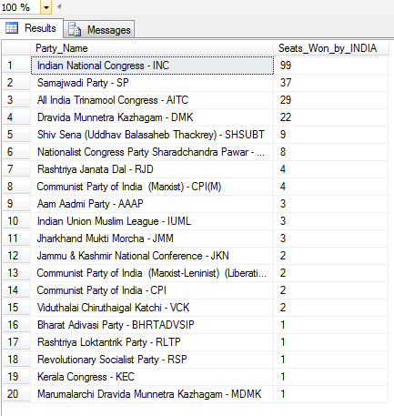
--Seats Won by INDIA Alliance Party. Query: SELECT partywise_results.Party AS Party_Name, partywise_results.Won AS Seats_Won_by_INDIA FROM partywise_results WHERE partywise_results.[Party] IN( 'Indian National Congress - INC', 'Aam Aadmi Party - AAAP', 'All India Trinamool Congress - AITC', 'Bharat Adivasi Party - BHRTADVSIP', 'Communist Party of India (Marxist) - CPI(M)', 'Communist Party of India (Marxist-Leninist) (Liberation) - CPI(ML)(L)', 'Communist Party of India - CPI', 'Dravida Munnetra Kazhagam - DMK', 'Indian Union Muslim League - IUML', 'Jammu & Kashmir National Conference - JKN', 'Kerala Congress - KEC', 'Jharkhand Mukti Morcha - JMM', 'Marumalarchi Dravida Munnetra Kazhagam - MDMK', 'Nationalist Congress Party Sharadchandra Pawar - NCPSP', 'Rashtriya Janata Dal - RJD', 'Rashtriya Loktantrik Party - RLTP', 'Revolutionary Socialist Party - RSP', 'Samajwadi Party - SP', 'Shiv Sena (Uddhav Balasaheb Thackrey) - SHSUBT', 'Viduthalai Chiruthaigal Katchi - VCK') ORDER BY partywise_results.Won DESC;
OUTPUT:

Slide 8
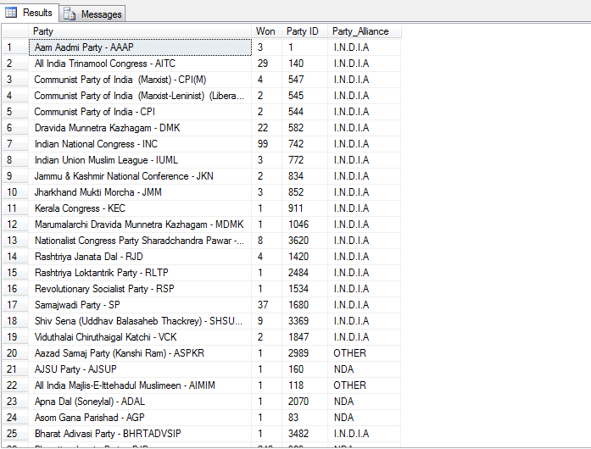
--Add new Column to find out the Party_Alliance names for each column. Query: ALTER TABLE partywise_results ADD Party_Alliance VARCHAR(250); UPDATE partywise_results SET Party_Alliance= 'I.N.D.I.A' WHERE partywise_results.Party IN( 'Indian National Congress - INC', 'Aam Aadmi Party - AAAP', 'All India Trinamool Congress - AITC', 'Bharat Adivasi Party - BHRTADVSIP', 'Communist Party of India (Marxist) - CPI(M)', 'Communist Party of India (Marxist-Leninist) (Liberation) - CPI(ML)(L)', 'Communist Party of India - CPI', 'Dravida Munnetra Kazhagam - DMK', 'Indian Union Muslim League - IUML', 'Jammu & Kashmir National Conference - JKN', 'Kerala Congress - KEC', 'Jharkhand Mukti Morcha - JMM', 'Marumalarchi Dravida Munnetra Kazhagam - MDMK', 'Nationalist Congress Party Sharadchandra Pawar - NCPSP', 'Rashtriya Janata Dal - RJD', 'Rashtriya Loktantrik Party - RLTP', 'Revolutionary Socialist Party - RSP', 'Samajwadi Party - SP', 'Shiv Sena (Uddhav Balasaheb Thackrey) - SHSUBT', 'Viduthalai Chiruthaigal Katchi - VCK'); UPDATE partywise_results SET Party_Alliance= 'NDA' WHERE partywise_results.Party IN( 'Bharatiya Janata Party - BJP', 'Telugu Desam - TDP', 'Janata Dal (United) - JD(U)', 'Shiv Sena - SHS', 'AJSU Party - AJSUP', 'Apna Dal (Soneylal) - ADAL', 'Asom Gana Parishad - AGP', 'Hindustani Awam Morcha (Secular) - HAMS', 'Janasena Party - JnP', 'Janata Dal (Secular) - JD(S)', 'Lok Janshakti Party(Ram Vilas) - LJPRV', 'Nationalist Congress Party - NCP', 'Rashtriya Lok Dal - RLD', 'Sikkim Krantikari Morcha - SKM'); UPDATE partywise_results SET Party_Alliance= 'OTHER' WHERE partywise_results.Party IN('Aazad Samaj Party (Kanshi Ram) - ASPKR', 'All India Majlis-E-Ittehadul Muslimeen - AIMIM', 'Independent - IND', 'Shiromani Akali Dal - SAD', 'United People’s Party, Liberal - UPPL', 'Voice of the People Party - VOTPP', 'Yuvajana Sramika Rythu Congress Party - YSRCP', 'Zoram People’s Movement - ZPM');
OUTPUT:

Slide 9
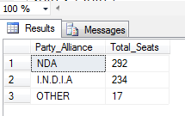
--Party Alliance that won the most seats across the all states. Query: SELECT partywise_results.Party_Alliance, SUM(partywise_results.Won) AS Total_Seats FROM partywise_results GROUP BY partywise_results.Party_Alliance ORDER BY SUM(partywise_results.Won) DESC;
OUTPUT:

Slide 10

--Winning candidate name, Party name, Total votes, The margin of victory, State Of Kaziranga Constituency. Query: SELECT constituencywise_results.[Winning Candidate], partywise_results.Party, partywise_results.Party_Alliance, constituencywise_results.[Total Votes], constituencywise_results.Margin, states.[State], constituencywise_results.[Constituency Name] FROM constituencywise_results JOIN partywise_results ON constituencywise_results.[Party ID]=partywise_results.[Party ID] JOIN statewise_results ON statewise_results.[Parliament Constituency]=constituencywise_results.[Parliament Constituency] JOIN states ON states.[State ID]=statewise_results.[State ID] WHERE constituencywise_results.[Constituency Name]='KAZIRANGA';
OUTPUT:

Slide 11
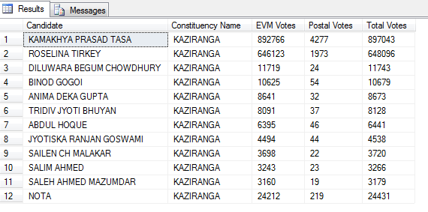
--Distribution of EVM Votes Vurses Postal Votes for Cadidates in KAZIRANGA. Query: SELECT constituencywise_details.Candidate, constituencywise_results.[Constituency Name], constituencywise_details.[EVM Votes], constituencywise_details.[Postal Votes], constituencywise_details.[Total Votes] FROM constituencywise_details JOIN constituencywise_results ON constituencywise_details.[Constituency ID]=constituencywise_results.[Constituency ID] WHERE constituencywise_results.[Constituency Name]='KAZIRANGA';
OUTPUT:

Slide 12
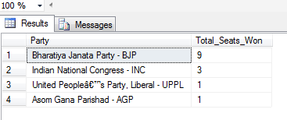
--Find which party won the most seats in Assam state and how many seats did each party win. Query: Select partywise_results.Party, COUNT(constituencywise_results.[Constituency ID]) AS Total_Seats_Won FROM partywise_results JOIN constituencywise_results ON partywise_results.[Party ID]=constituencywise_results.[Party ID] JOIN statewise_results ON constituencywise_results.[Parliament Constituency]=statewise_results.[Parliament Constituency] JOIN states ON states.[State ID]=statewise_results.[State ID] WHERE states.[State]='Assam' GROUP BY partywise_results.Party ORDER BY COUNT(constituencywise_results.[Constituency ID])DESC;
OUTPUT:

Slide 13
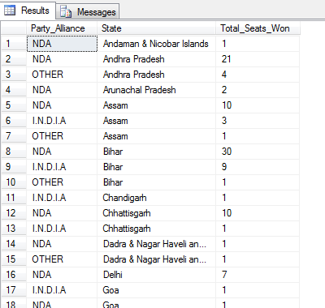
--Total number of seats won by each party alliance(NDA,I.N.D.I.A & OTHER) in each states. Query: SELECT partywise_results.Party_Alliance, states.[State], COUNT(constituencywise_results.[Constituency ID]) AS Total_Seats_Won FROM partywise_results JOIN constituencywise_results ON partywise_results.[Party ID]=constituencywise_results.[Party ID] JOIN statewise_results ON constituencywise_results.[Parliament Constituency]=statewise_results.[Parliament Constituency] JOIN states ON states.[State ID]=statewise_results.[State ID] GROUP BY partywise_results.Party_Alliance, states.[State] ORDER BY states.[State], COUNT(constituencywise_results.[Constituency ID]) DESC;
OUTPUT:

Slide 14
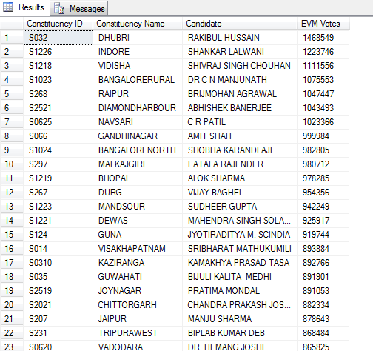
--Candidate name that Received the highest number of EVM votes in Each Constituency. Query: SELECT RC.[Constituency ID], RC.[Constituency Name], RC.Candidate, RC.[EVM Votes] FROM ( SELECT constituencywise_details.[Constituency ID], constituencywise_results.[Constituency Name], constituencywise_details.Candidate, constituencywise_details.[EVM Votes], ROW_NUMBER() OVER(PARTITION BY constituencywise_details.[Constituency ID] ORDER BY constituencywise_details.[EVM Votes] DESC) AS rank_position FROM constituencywise_details JOIN constituencywise_results ON constituencywise_details.[Constituency ID]=constituencywise_results.[Constituency ID] ) AS RC WHERE RC.rank_position=1 ORDER BY RC.[EVM Votes] DESC;
OUTPUT:

